Slide 1
BANK LOAN CASE STUDY

Slide 2
When a client applies for a loan, there are four types of decisions that could be taken by the client/company:
APPROVED | CANCELLED | REFUSED | UNUSED
The company has approved the loan application. | Either client cancelled the application sometime during approval. Client changed his/her mind about the loan. Due to higher risk. | The company had rejected the loan (because the client does not meet their requirements). | Loan has been cancelled by the client but on different stages of process.

Slide 3
DESCRIPTION
In this case study, apart from applying the techniques learnt in the earlier modules we will also develop a basic understanding of risk analytics in banking and financial services and understand how data is used to curb the risk of losing money while lending to coustomers.
Risk analysis is a multi-step process aimed at mitigating the impact of risks on business operations. Leaders from different industries use risk analysis to ensure that all aspects of the business are protected from potential threats. Performing regular risk analysis also minimizes the vulnerability of the business to unexpected events.

Slide 4
APPROACH
I have analyzed the database carefully. Observed all the tables,columns, rows. Afterwards check all the content carefully. Then one by one. I have executed queries according to the questions asked.In this project I have learned a lot of new things like how to check data imbalance, how to find correlation between variables, finding outliers, visualizing data and many more.

Slide 5
TECH STACK USED
Microsoft Excel 2019(Version 2210 Build
16.0.15726.20188) and
Microsoft Powerpoint 2019 (Version 2210 Build 16.0.15726.20188).

Slide 6
INSIGHTS
In the above assignment I have used Microsoft Excel to derive the conclusions needed. Firstly I assessed the data rendered by the Trainity team and discovered how to visualise the data ,after that I ran various Excel formulas Including Pivot Table(Microsoft Excel’s most amazing function) to acquire insights and understanding of how to handle real time case study through this assignment. I extracted several insights from the data set including outliers,correlation,data imbalance. While working on this assignment I discovered how to use formulas,how to visulazie data and so on.

Slide 7
RESULTS

Slide 8
DATA REGARDING MISSING VALUES
INTERPRETATION:
The above graph depicits the name of coloumns having high number of missing values.As we can see that nonlivingapartments_medi is having the highest number of missing values followed by livingapartments_avg and so on.

Slide 9
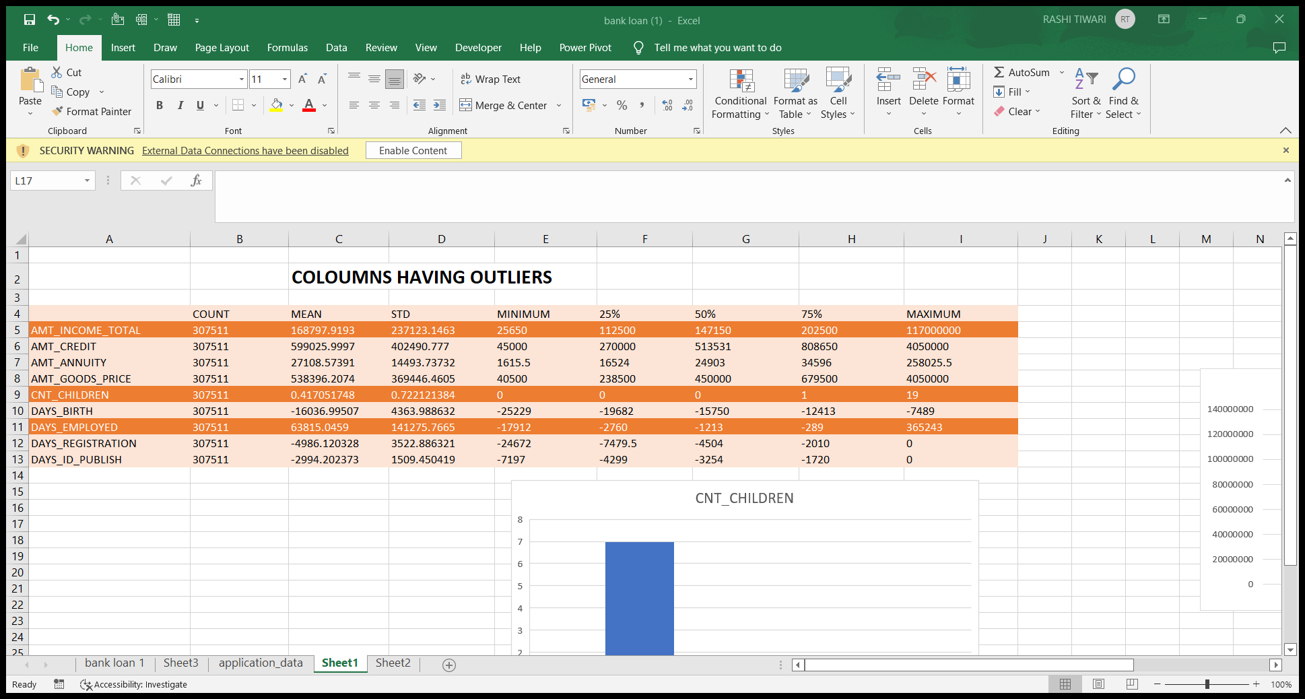
IDENTIFING OUTLIERS
Checking the outliers for coloumns and understanding the reason to mention that as an outlier.
Here is my analysis to find out the outliers, I have considered few numerical coloumns and analyzed them using statistics.
If we observe the above table , there are three coloumns with outlier values which are having a huge difference compared to the regular intervals of other values

Slide 10
AMT_TOTAL_INCOME: As maximum amount 117000000 is way above the mean and the 75th percentile, hence we will consider there are outliers present in this coloumn.

Slide 11
CNT_CHILDREN: As shown ithe above chart, there is a value 19. As humans cannot have so many children we will consider this as an outlier.

Slide 12
DAYS_EMPLYOED: There is a value present here 365243, which is extremely high. It might be due to an error in the data, hence we will treat this as an outlier.

Slide 13
DATA IMBALANCE
INTERPRETATION:
We observe that the application data is highly imbalanced. Defaulted population is 7% and non- defaulted population is 93% .

Slide 14
CATEGORICAL AND NUMERICAL UNIVARIATE ANALYSIS W.R.T TO TARGET VARIABLE 0

Slide 15
INTERPRETATION:
Female counts are higher than male.
Income Range 100000 to 200000 is having more number of credits.
The graph represents that females are more than males in having credit for that range.

Slide 16
INTERPRETATION:
For contract type ‘Cash loans’ is having higher number of credits than ‘Revolving loans’ contract type.
Females are in lead for applying credits in case of contract type as well.

Slide 17
INTERPRETATION:
Clients which applied for credits are from the organisation type ‘Business Entity Type 3’ , Self Employed’ , ‘Other’ , ‘Medicine’ and ‘Government’.
Less clients from industry type 8, type 6, type 10, religion and trade type 5, type 4.

Slide 18
CATEGORICAL AND NUMERICAL UNIVARIATE ANALYSIS W.R.T TO TARGET VARIABLE 1

Slide 19
INTERPRETATION:
Female count is higher than males.
The graph shows that females are more than males in having credit.
The income range from 1200 to 1400 are having more number of credits.

Slide 20
INTERPRETATION:
For contract type ‘Cash loans’ is having higher number of credits than ‘Revolving loans’ contract type.
For this also Femals are in lead for applying credits.
For Target 1 males are almost negligble in ‘Revolving Loans’.

Slide 21
INTERPRETATION:
Clients which applied for credits are from the organisation type ‘Business Entity Type 3’ , Self Employed’ , ‘Other’ , ‘Medicine’ and ‘Government’.
Less clients from industry type 8, type 6, type 10, religion and trade type 5, type 4.
Same as Type 0 in the distribution of organization type.

Slide 22
CATEGORICAL AND NUMERICAL BIVARIATE ANALYSIS W.R.T TO TARGET VARIABLE 0

Slide 23
INTERPRETATION:
Clinets with all type of family statuses having academic degrees have very less outliers as compared to other types of educational status.
Clients having Higher Education,Incomplete Higher Education,Lower Secondary Education and Secondary/Secondary Special have a high number of outliers.
From the above chart , we can say that some of the clients having Higher Education tend to have the highest income compared to others.
Some of the clients having Secondary/Secondary Special Education tend to have higher incomes.

Slide 24
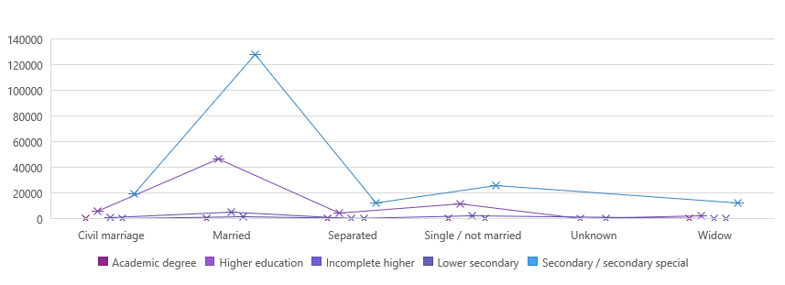
Distribution of Credit as per Educational Status
INTERPRETATION:
Clients with different education types except Academic degrees have a large number of outliers.
Most of the population i.e. clients credit amount lie below 25%.
Clients with an academic degree and who is a widow tend to take higher credit loan.
Some of the clients with higher education, incomplete higher education, lower secondary education and secondary/secondary special education are more likely to take high amount of credit loans.

Slide 25
CATEGORICAL AND NUMERICAL BIVARIATE ANALYSIS W.R.T TO TARGET VARIABLE 1

Slide 26
INTERPRETATION:
The income amount of married clients with an academic degree is more as compared to others.
Clients who default have relatively less income as compared to non-defaulters.

Slide 27
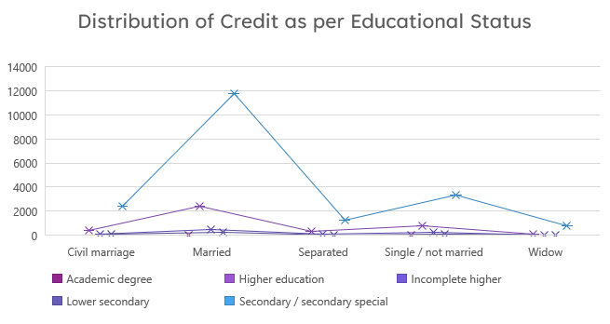
INTERPRETATION:
Married client with academic degrees applied for a higher credit loan and doesn’t have outliers.
Some of the clients with higher education ,incomplete higher education, lower secondary education and secondary/secondary special education are more likely to take higher credit loans.

Slide 28
CORRELATION BETWEEN TARGET VARIABLES

Slide 29
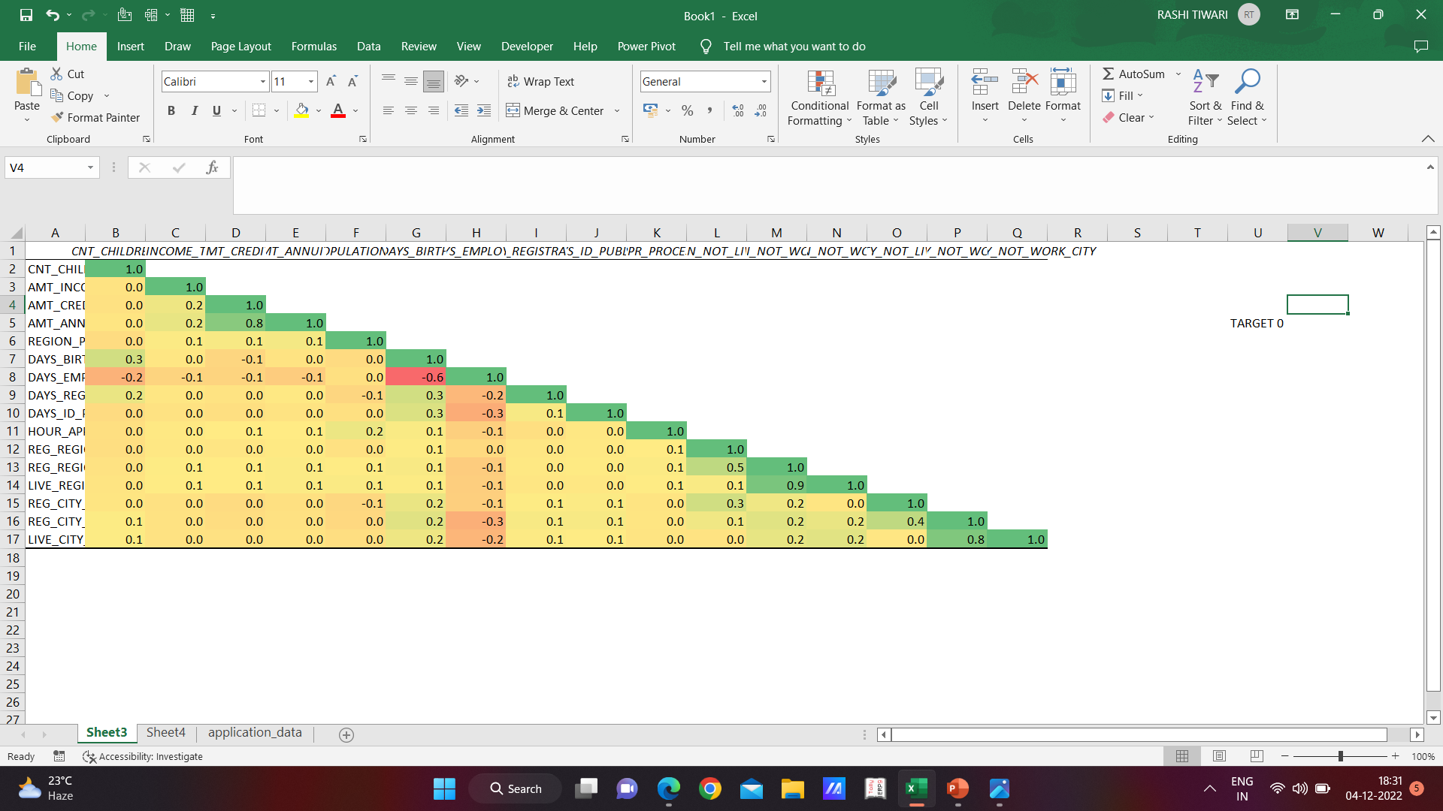
FOR TARGET 0

Slide 30
INTERPRETATION:
Credit amount is inversely proportional to the date of birth, which means credit amount is higher for low age group and vice-versa.
Credit amount is inversely proportional to the number of children client have, means credit amount is higher for less children count client have and vice-versa.
Income amount is inversely proportional to the number of children client have, means more income for less children client have and vice-versa.
Less children client are in densely populated area.
Credit amount is higher for densely populated area.
The income is also higher in densely populated area.

Slide 31
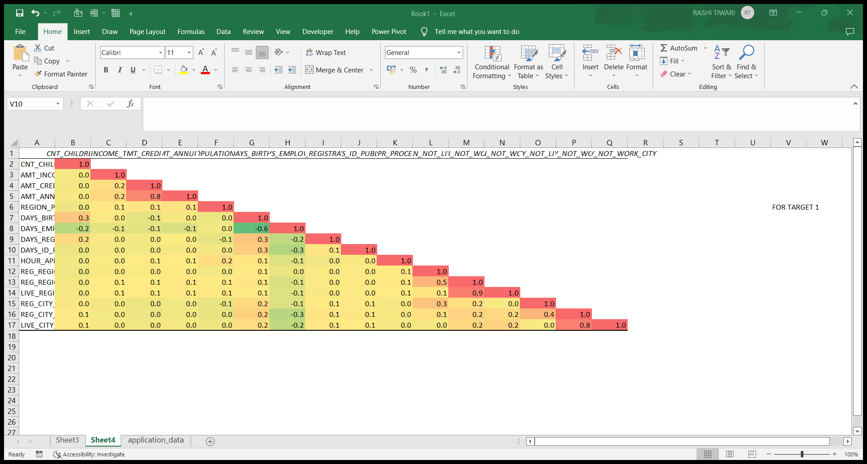
FOR TARGET 1

Slide 32
INTERPRETATION:
The clients permanent address does not match contact address are having less children and vice-versa
The clients permanent address does not work address are having less children and vice-versa.

Slide 33
Areas of focus
Banks should focus more on contract type ‘Student’ , ‘Pensioner’ and ‘Businessman’ with housing type and other than co-op apartment’ for successful payments
Banks should focus less on income type ‘working’ as they are having most number of unsuccessfull payments.
Get as much as clients from housing type ‘With Parents’ as they are having least number of unsuccessfull payments.

Slide 34
Thank you
Rashi Tiwari
tiwarirashi322@gmail.com

